Slide 1
Buffers
Buffer:
  Doesn’t change the input.
  Only amplifies.
EN
in
out

Slide 2
Three-State Buffers
  Buffer output has 3 states: 0, 1, Z
  Z stands for High-Impedance ≅ Open circuit
EN = 0 ➔ out = Z (open circuit)
EN = 1 ➔ out = in (regular buffer)
EN
EN | in | out
0 | X | Z
1 | 0 | 0
1 | 1 | 1
in
out

Slide 3
Three-state buffer(BUF)/inverter(INV) symbols
EN
EN
in
out
in
out
3-state BUF, EN high
3-state INV, EN high
EN
EN
in
out
in
out
3-state BUF, EN low
3-state INV, EN low

Slide 4
Open Collector/Drain Gates
  Outputs of two (or more) gates must not be wired together:
A
If A = B
→ out = A = B
If A ≠ B
→ a large enough current
can be created, that causes excessive
heating and could damage the circuit.
out
B
wired

Slide 5
Multiplexed output lines using three-state buffers
S | A | B | EN_{A} | EN_{B} | out
0 | 0 | 0 | 1 | 0 | 0
0 | 0 | 1 | 1 | 0 | 0
0 | 1 | 0 | 1 | 0 | 1
0 | 1 | 1 | 1 | 0 | 1
1 | 0 | 0 | 0 | 1 | 0
1 | 0 | 1 | 0 | 1 | 1
1 | 1 | 0 | 0 | 1 | 0
1 | 1 | 1 | 0 | 1 | 1
EN_{A}
A
A
out
B
EN_{B}
S
B
A
0
out
B
1
S

Slide 6
Open Collector/Drain Gates
  Outputs of some gates can be wired:
    The result: O₁ AND O₂
      Open Collector Gates in TTL Technology
      Open Drain Gates in CMOS Technology
A
O₁
Out =
O₁ . O₂
B
O₂

Slide 7
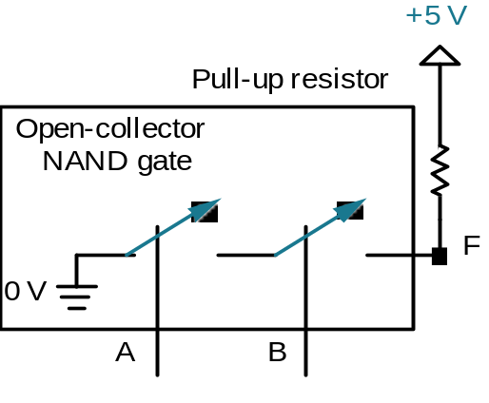
Open Collector/Drain Gates
  Open Collector (Open Drain) NAND Truth Table:
Z (Hi-Z) (Hi-Impedance):
  As if it is unconnected.
OD
A | B | F=(A•B)’
0 | 0 | Z
0 | 1 | Z
1 | 0 | Z
1 | 1 | 0
  The gate cannot pull up the output
    → needs a resistor to pull it up if an input is ‘0’

Slide 8
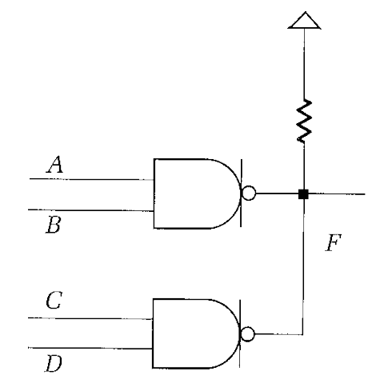
Open Collector/Drain Gates
Wired AND:
If A and B are "1", output is actively pulled low
if C and D are "1", output is actively pulled low
if one gate is low, the other high, then low wins
if both gates are "1", the output floats, pulled
high by resistor
Hence, the two NAND functions are AND'd (wired)
together!
Pull-up resistor
Open-collector
NAND gate
F
0 V
C
D
OD
OD

Slide 9
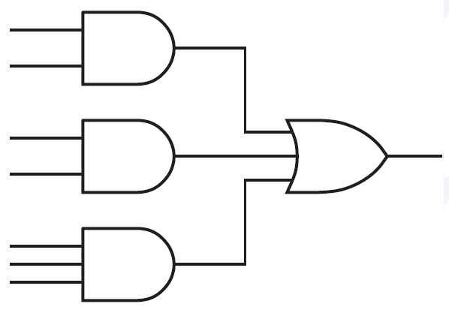
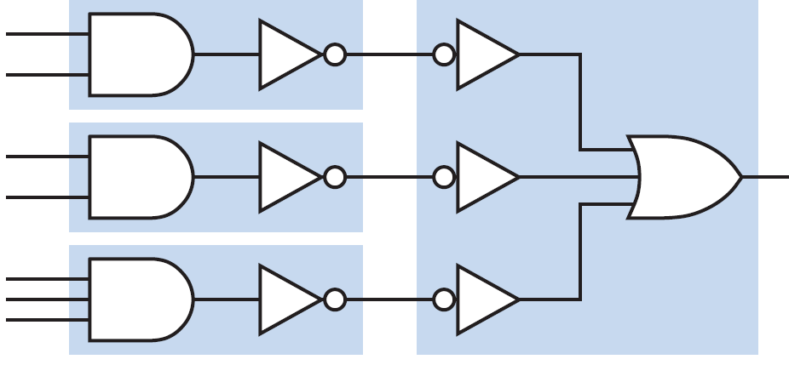
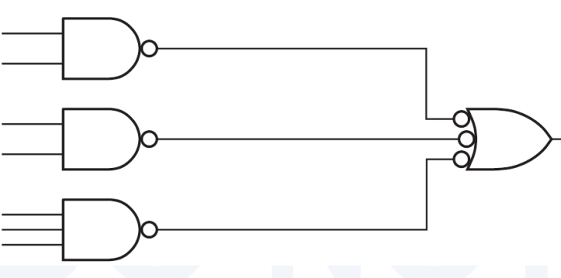
NAND-Only Implementation
  Find Sum-of-Product form.
  Inventers can be added
  Equivalent NAND-only

Slide 10

NAND-Only Implementation
  NAND = AND + NOT
  Use Open Collector/Drain NAND Gates:
OD
OD
OD

Slide 11
Another Method
  Instead of finding the circuit for F, find the circuit for F’ in the first stage
    Then there will be no Inverter at the output
OD
OD
OD
Wired OR:
  Open drain/collector gate with active low inputs.

Slide 12
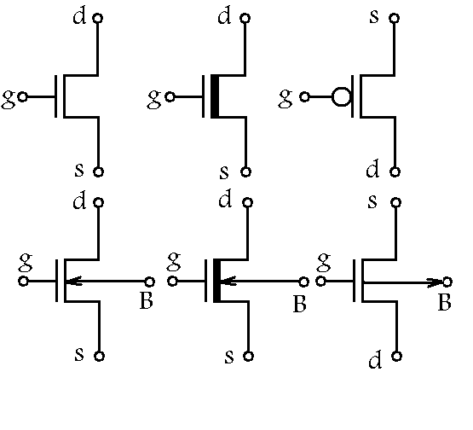
MOSFET Transistors
NMOS
PMOS
g = 0: switch is open
g = 0: switch is closed
g = 1: switch is closed
g = 1: switch is open

Slide 13
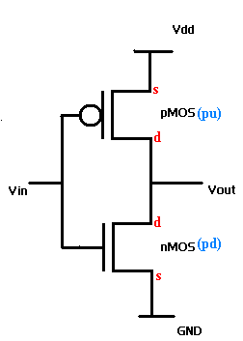
CMOS Inverter
Vin = 0: NMOS is open, PMOS is closed
Vout = 1
Vin = 1: NMOS is closed, PMOS is open
Vout = 0

Slide 14
CMOS NAND
V_{dd}
b
a
a b ab
0 0
0 1
1 0
1 1
ab
1
1
1
b
0
gnd

Slide 15
CMOS NOR
V_{dd}
b
a b a+b
0 0
0 1
1 0
1 1
a+b
1
a
0
b
0
0
gnd

Slide 16
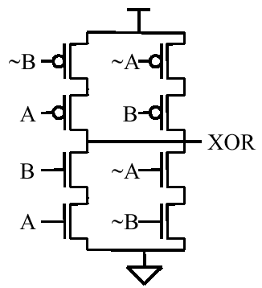
CMOS XOR

Slide 17
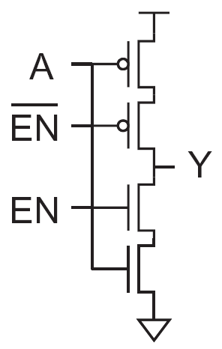
CMOS 3-State (Tri-State) Inverter

Slide 18
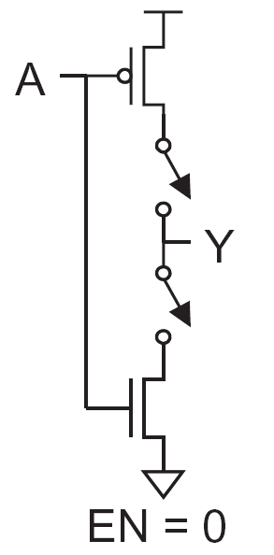
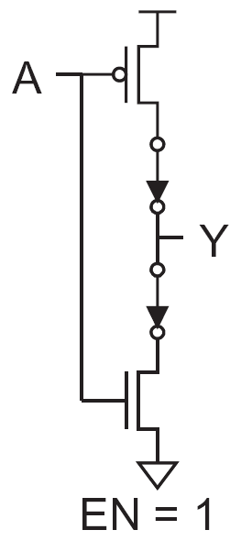

Slide 19
Tri-State Buffer

